Slide 1
Preliminary IoT DDS Performance Test Analysis
Michael A. Walker
Vandebilt University

Slide 2
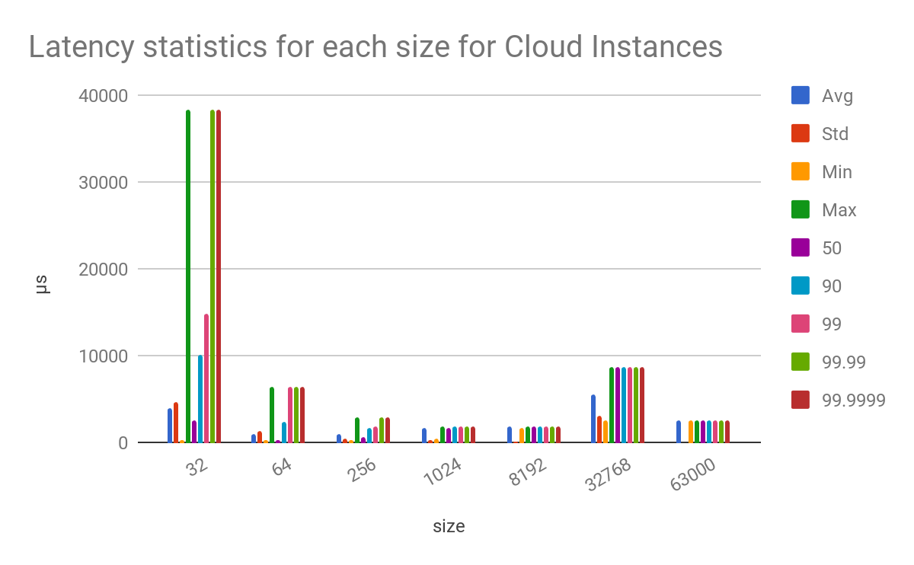

Slide 3
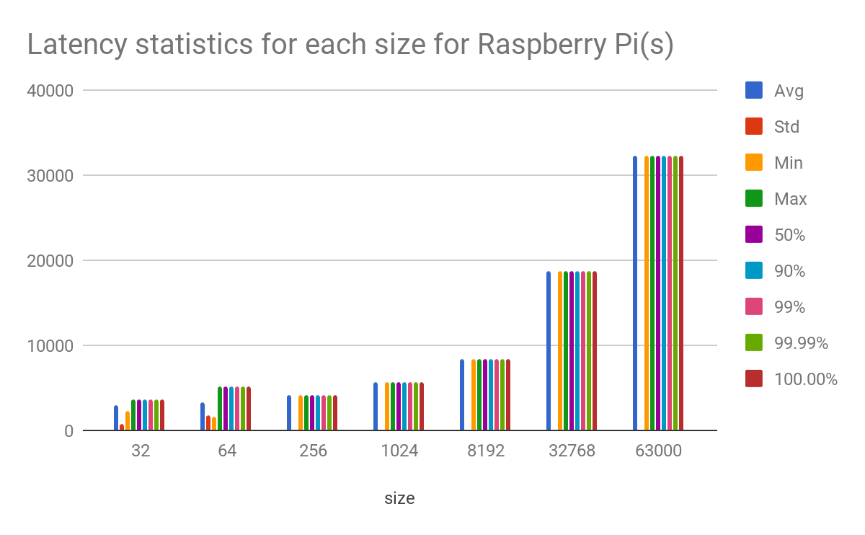

Slide 4
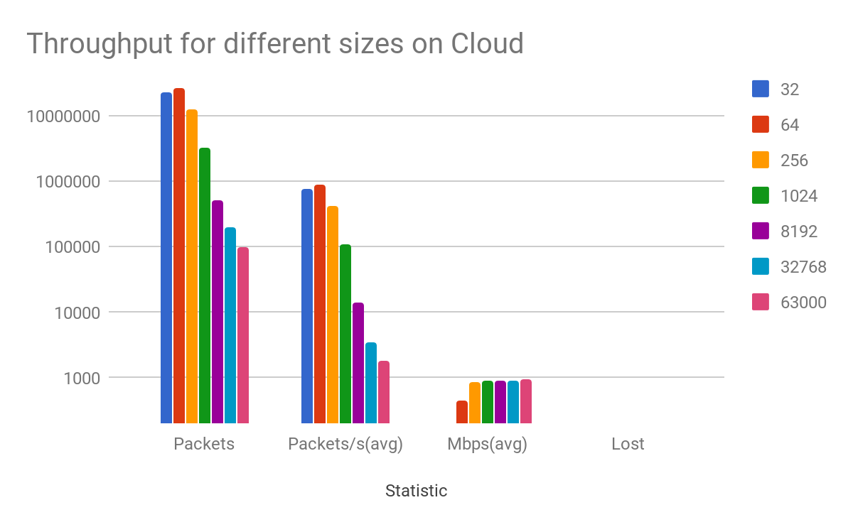

Slide 5
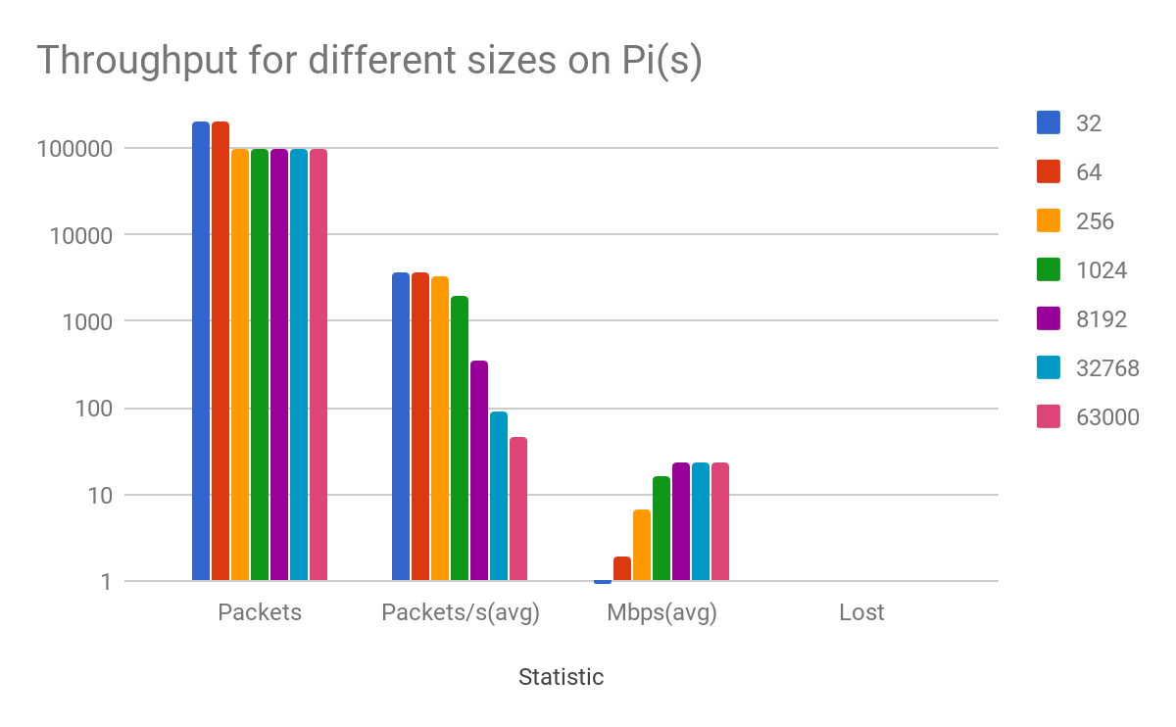

Slide 6
Tests can’t complete in 2min above 4098 bytes/msg
The following test sizes were ran each after a constant test of 64 bytes/msg. with 2min per test part.
These results were over WiFi, Further testing needs to be done for over ethernet
The tests above 4098 were not able to complete in the 2 minute time limit and therefore were unable to properly calculate min, max, standard deviation, and percentiles properly
Previous charts were done with 30 second time limits per size test, same behavior is demonstrated with 1024+ not completing fully.
128 b/msg = 4:50 s
256 b/msg = 4:28 s
1024 b/msg = 4:57 s
2048 b/msg = 5:40 s
4098 b/msg = 5:03 s
-----------------
8196 b/msg = 7:05 s
16384 b/msg = 11:36 s

